Slide 1
Problem/formulation Sections
problem_formulation.Apr30.2019

Slide 2
2001.Lancia, page 2, 2nd paragraph Model: NP Input: SNP Matrix
“The basic problem addressed here is the Haplotyping, i.e., given a set of SNPs prospects inferred from the assembly alignment of a genomic region of a chromosome, find the maximally consistent pair of SNPs haplotypes by removing data “errors” related to DNA sequencing errors, repeats, and paralogous recruitment.” (2001.Lancia, page 1, abstract).
“The basic problem is to start from a set of SNPs prospects inferred from the assembly alignment and to find out the maximal consistent subset of SNPs by removing ”errors” related to sequencing errors, repeats, and paralogous recruitment.” (2001.Lancia, page 2, 2nd paragraph).

Slide 3
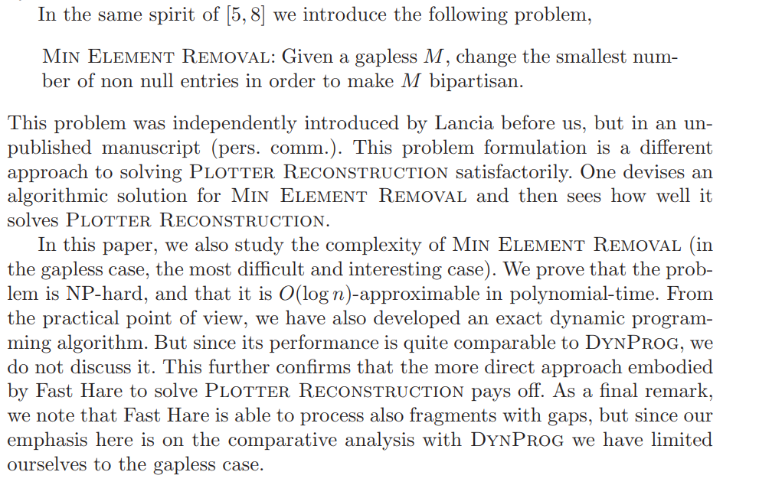
(2004.FastHare, page 4, paragraph 2) model: Heuristic Input: SNP Matrix

Slide 4
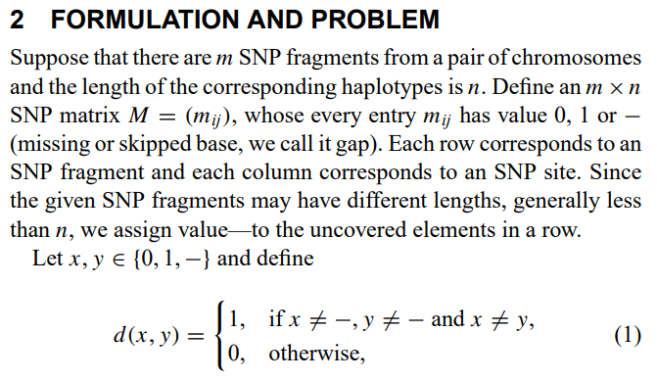
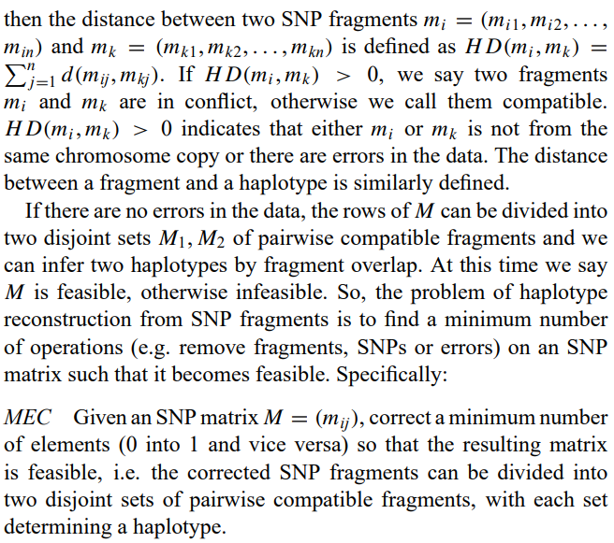
(2005.Wang, page 2, 2nd paragraph on left) Model: MEC Input: SNP Matrix

Slide 5
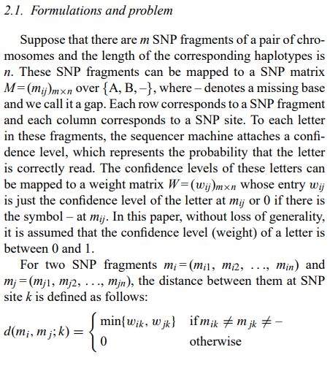
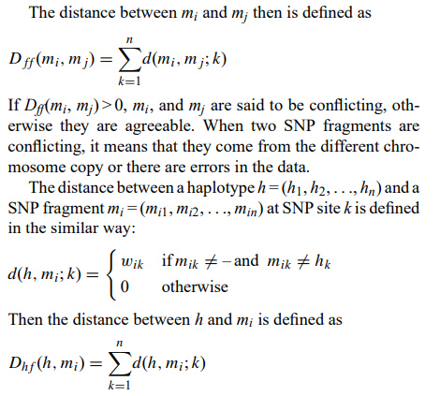
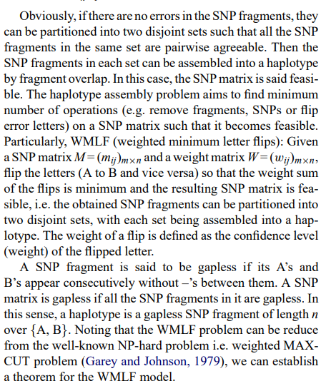
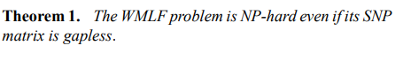
(2005.Zhao, page 2, last paragraph on left) Model: heuristic algorithm based on a dynamic clustering technique Input: SNP Matrix

Slide 6
(2007.BEAGLE, page 2, last paragraph) Model: HMM Input: Phased data
“Correlation between markers is a localized phenomenon, since LD decays with distance. If this localization is not considered when genotype data are phased over an extended region, noise will be introduced by sampling variation, resulting in apparent correlations observed between distant markers, which reduces the accuracy of the haplotype inference. Existing approaches to this problem include explicitly modeling the recombination in the coalescent model,15 using haplotype blocks,11,13 taking a sliding window approach with window size varying with LD structure,16 employing an HMM,7 and using frequent haplotype fragments.8 Our approach to making use of the localized LD structure is a localized haplotype-cluster model,1,12 which empirically models haplotype frequencies on a local scale”

Slide 7
2007.Levy.HuRef Model: Unknown Input: Unknown
“Notwithstanding, there are limitations with current SNP-based genome-wide association studies, because they rely on reconstructing haplotypes based on population data and can be uninformative or misleading in regions of low linkage disequilibrium (LD). Further, association studies have been designed to detect common disease variants and are not optimized to detect rare etiological variants [39].” (2007.Levy.HuRef, page 2, last paragraph on left)

Slide 8
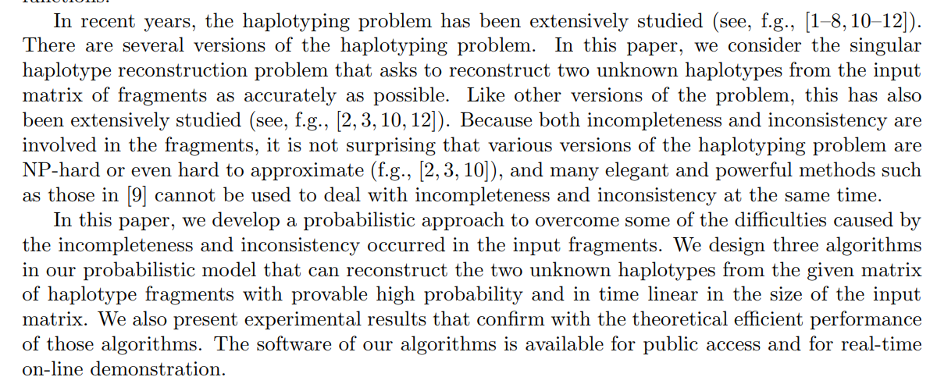
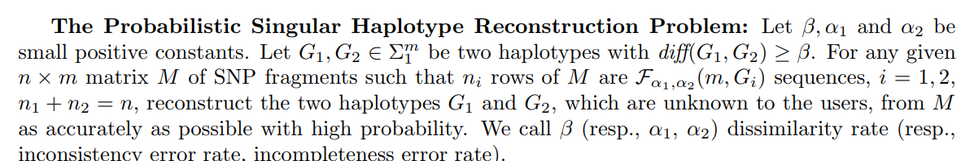
2008.Chen.HapRec, page 1, 2nd & 3rd Paragraphs Model: Probabilistic Input: SNP Matrix
Page 3, 1st paragraph

Slide 9
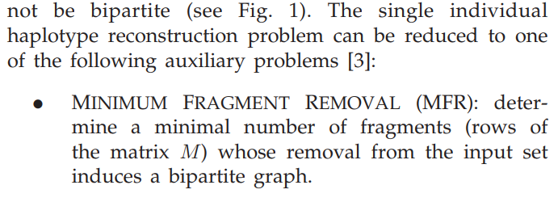
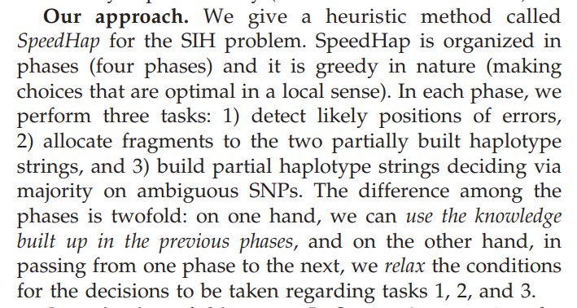
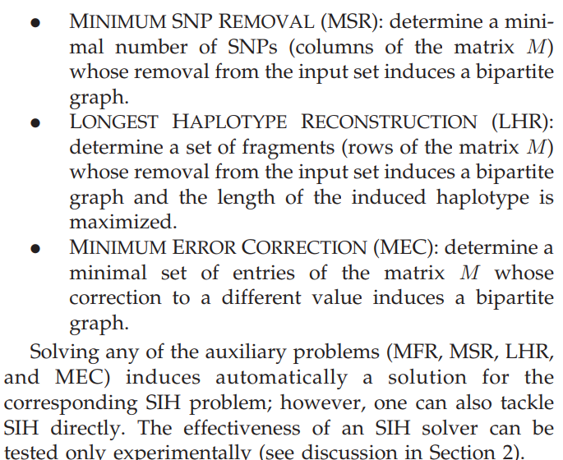
2008.Genovese.SpeedHap, page 3 1st paragraph Model: Heuristic Model Input: fragment set & SNP position set

Slide 10
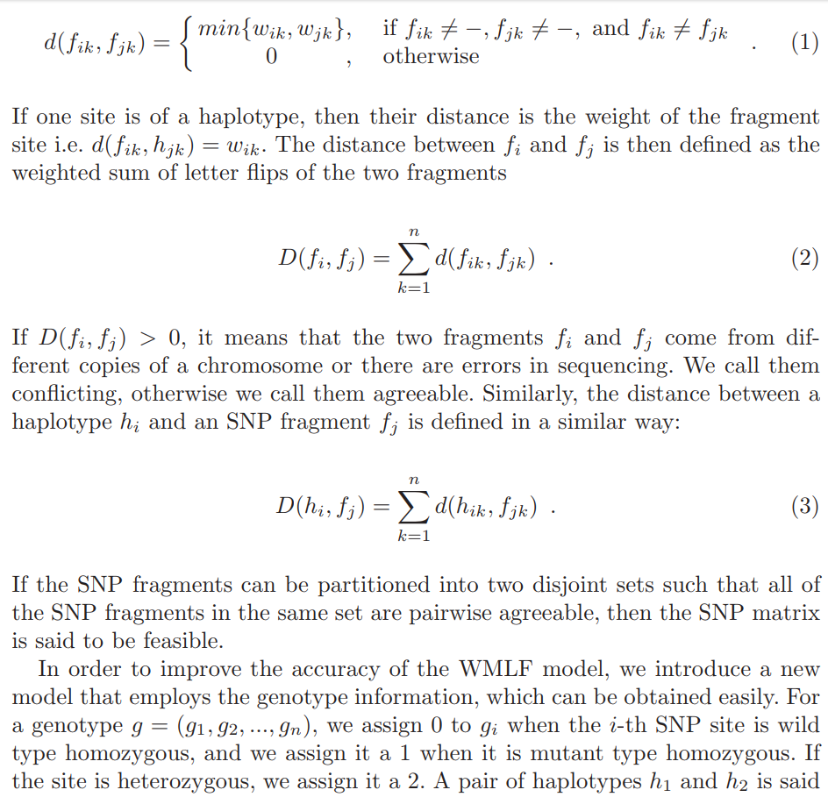
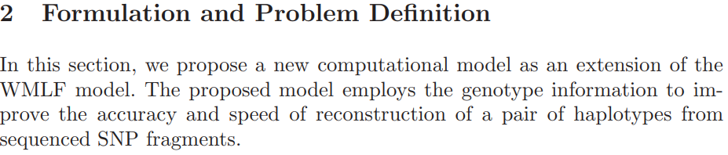
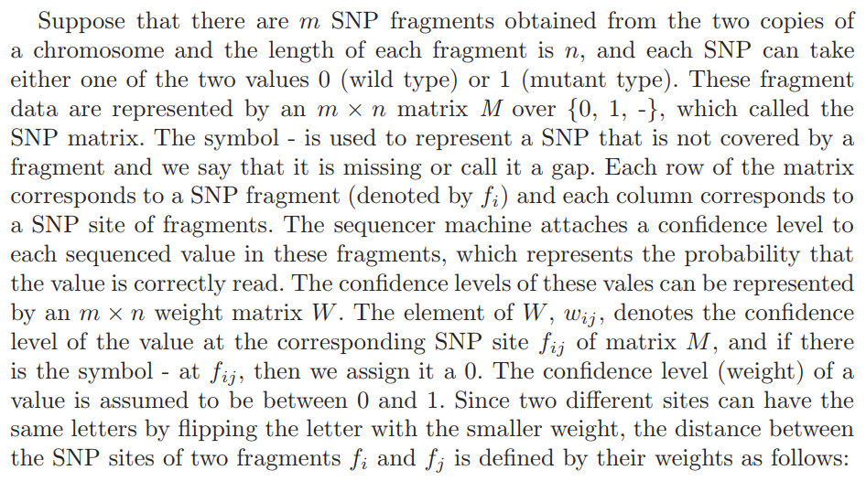
(2008.Kang, page 3-4, last-first paragraphs) Model: WMLF/GI Input: SNP Matrix

Slide 11
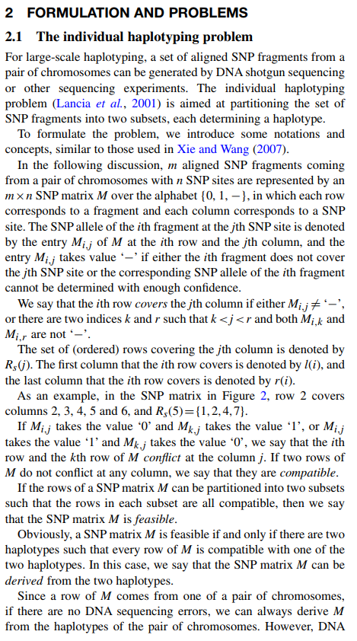
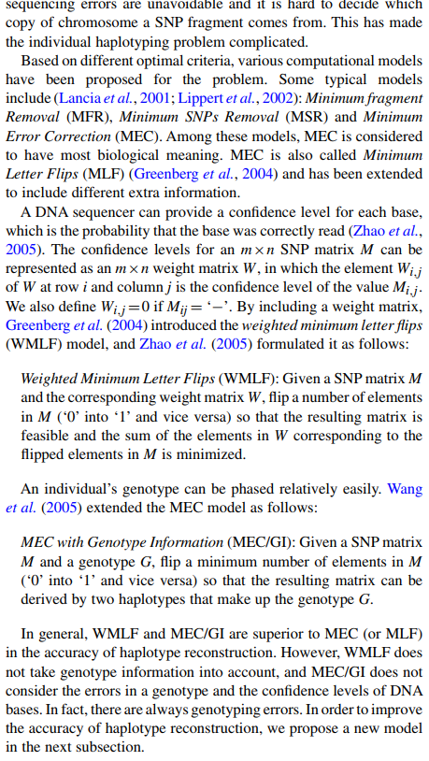
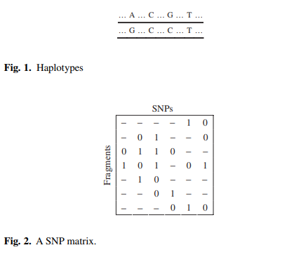
(2008.Xie.P_WMLF, page 2, first paragraph) Model: P-WMLF/GS Input: SNP Matrix, weight matrix, genospectrum weighted coifficient (gw)

Slide 12
2008.Bansal.HASH, page 2, 2nd paragraph on right Model: MCMC Input: Unknown
“For haplotype assembly to be feasible, one requires a high sequence coverage (sufficient overlaps between reads) and reads that are long enough to span multiple variant sites. Given the level of polymorphism in the human genome (∼0.1%), single shotgun reads (∼8,001,000 base pairs long) at 5–8X coverage would result in short haplotype segments. However, paired ends or mate pairs (pair of sequenced reads derived from the same shotgun clone) provide linkage information that can substantially increase the length of inferred haplotypes. Even with mate pairs, it is not possible to link all variants on a chromosome. A haplotype assembly for a diploid genome is a collection of haplotype segments or disjoint haplotypes. In the absence of errors in sequenced reads, the correct haplotype assembly is unique and is not difficult to derive. Errors in reads increase the space of possible solutions, making this problem computationally challenging. The problem of finding the haplotype assembly that optimizes a certain objective function (e.g., minimize the number of conflicts with the sequenced reads) has been explored from a theoretical perspective (Lippert et al. 2002; Rizzi et al. 2002; Halldorsson et al. 2003; Bafna et al. 2005) and has been shown to be computationally intractable for gapped reads (e.g., mate pairs). A statistical method was proposed (Li et al. 2004) for reconstructing haplotypes from sequenced reads aligned to a reference genome. The method is based on inferring local haplotypes using a Gibbs sampling approach and joining these local haplotypes using overlaps. This method has recently been extended (Kim et al. 2007) to include polymorphism detection as part of the haplotype reconstruction pipeline, and applied to the genome of Ciona intestinalis.” (2008.Bansal.HASH, page 2, 2nd paragraph on right).

Slide 13
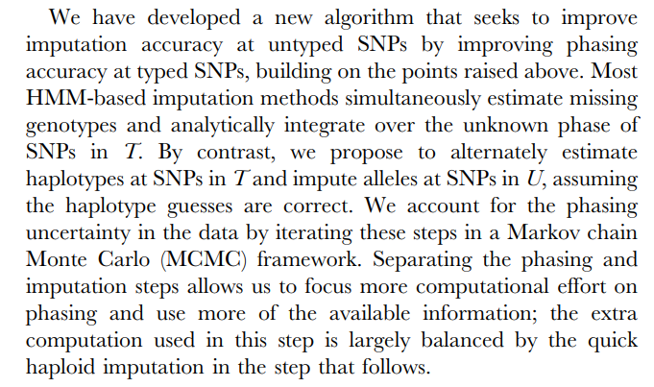
2009.Howie.IMPUTE2, page 2, last paragraph on right Model: genotype imputation method Input: Unknown

Slide 14
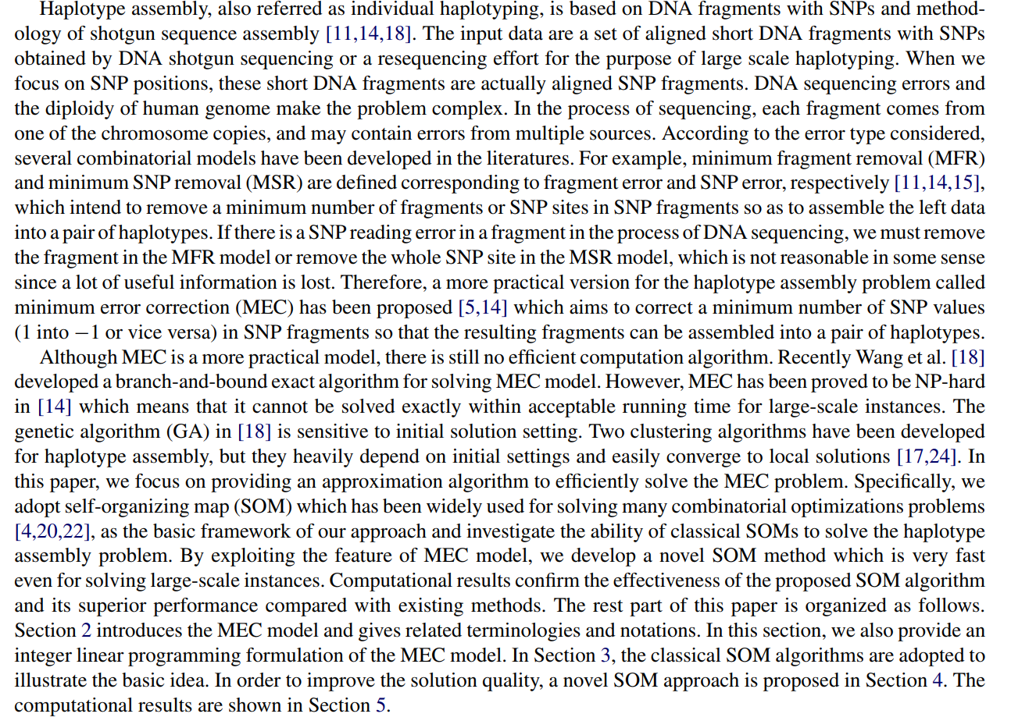
2009.Wu, page 2, 2nd & 3rd paragraph Model: self-organizing map method Input: SNP Fragments

Slide 15
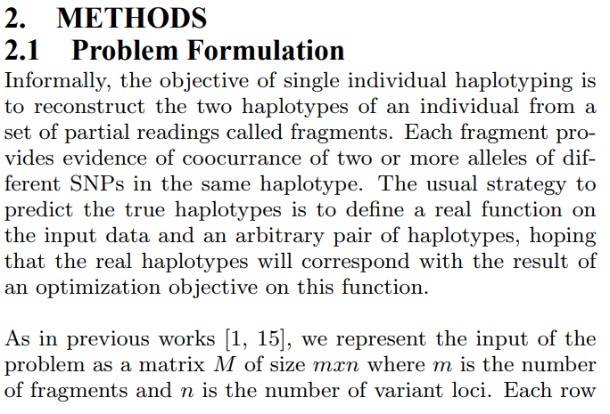
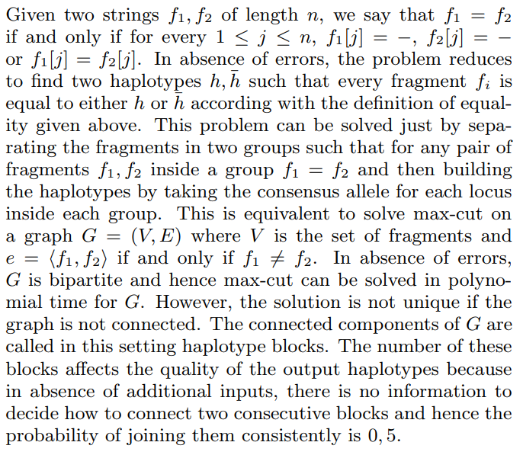
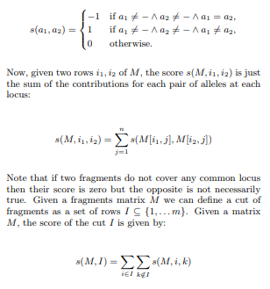
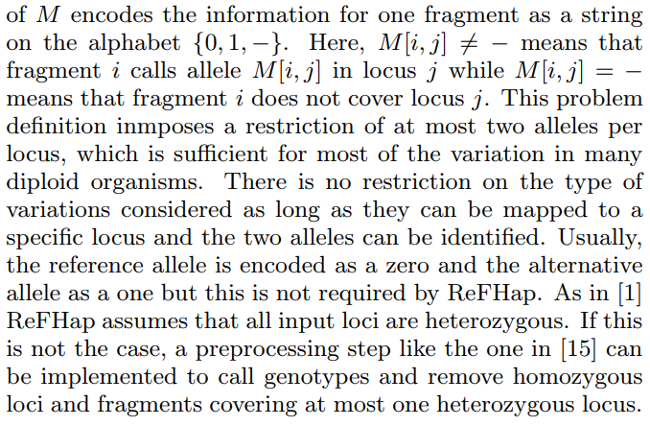
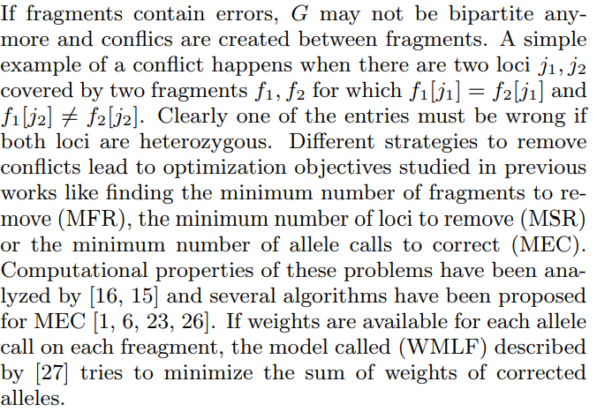
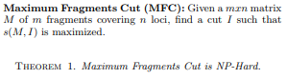
(2010.Duitama.ReFHap, page 2, last paragraph on right) Model: Heurist/Graph Input: fragment and variant loci matrix

Slide 16
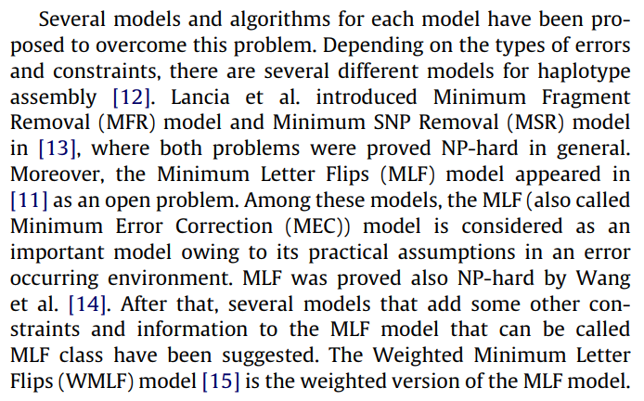
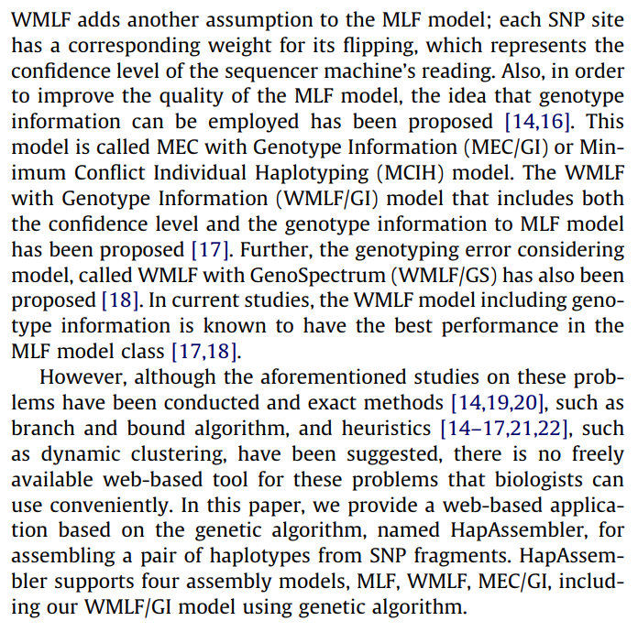
2010.Kang.HapAssembler, page 2, 1st paragraph Model: web-based application based on the genetic algorithm Input: SNP fragments matrix M

Slide 17
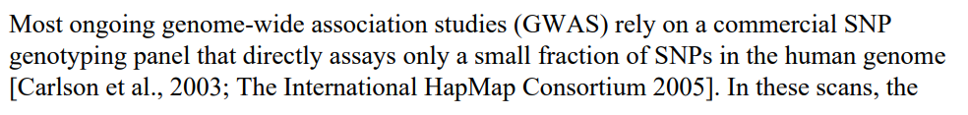
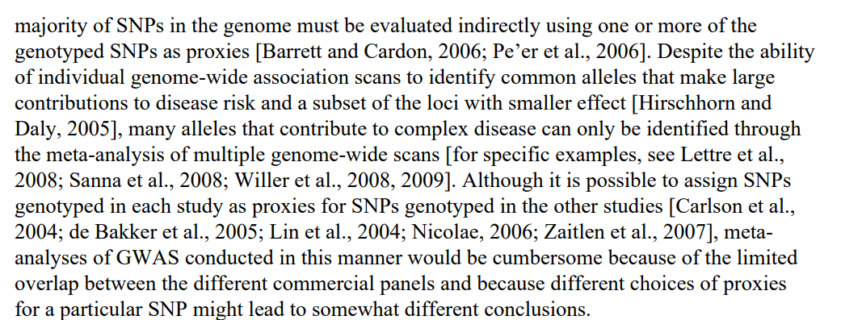
2010.Li.MaCH, page 2, 1st paragraph Model: MCMC Input: unphased genotypes

Slide 18
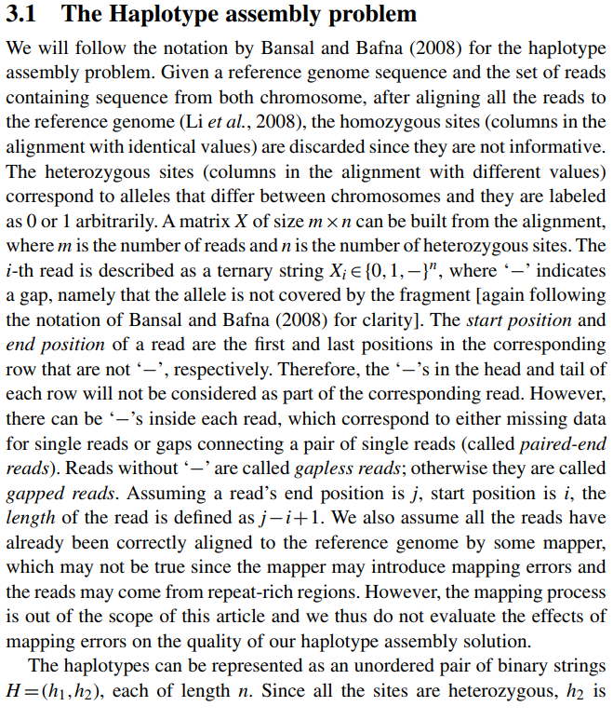
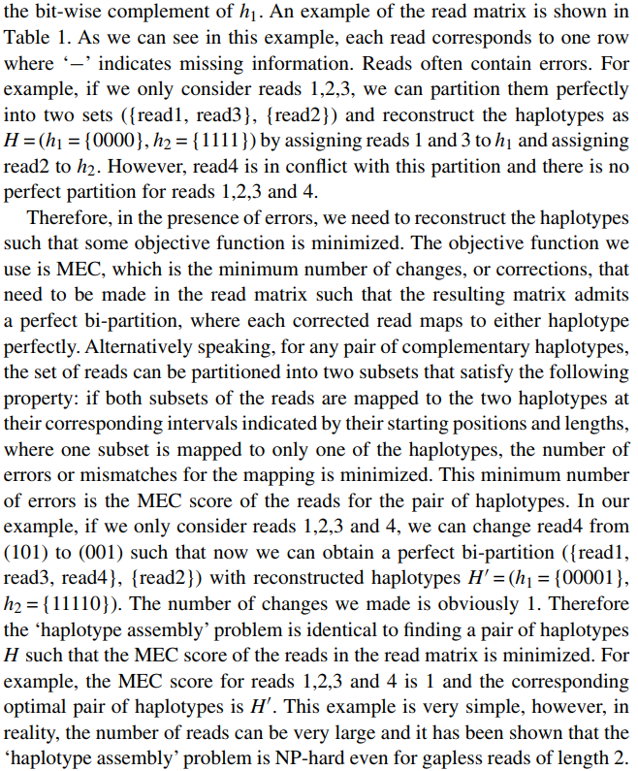
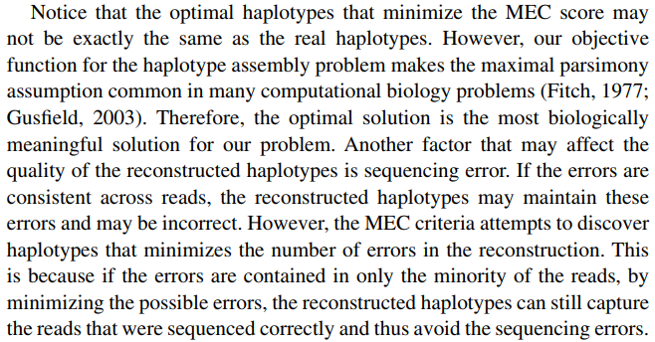
(2010.MaxSAT, page 2, last paragraph) Model: MEC Input: read & heterozygous sites matrix

Slide 19
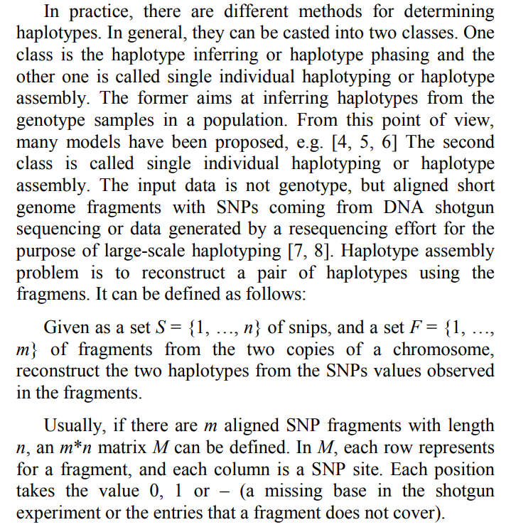
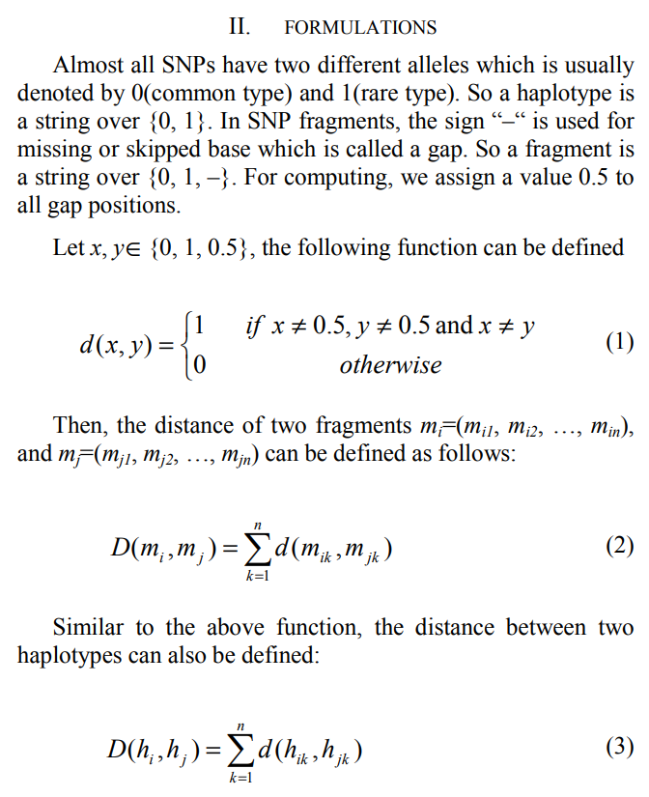
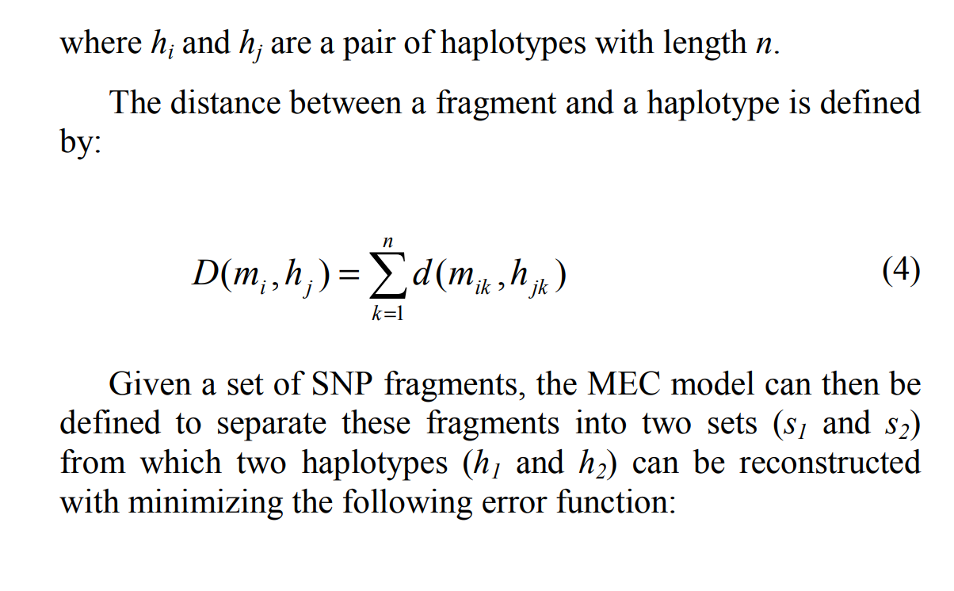
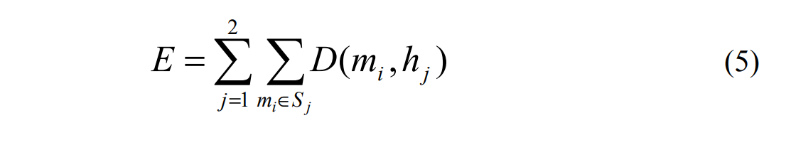
2010.Xu, pages 1 & 2 Model: MEC Input: SNP Fragments

Slide 20
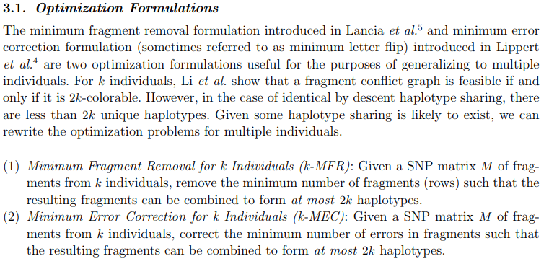
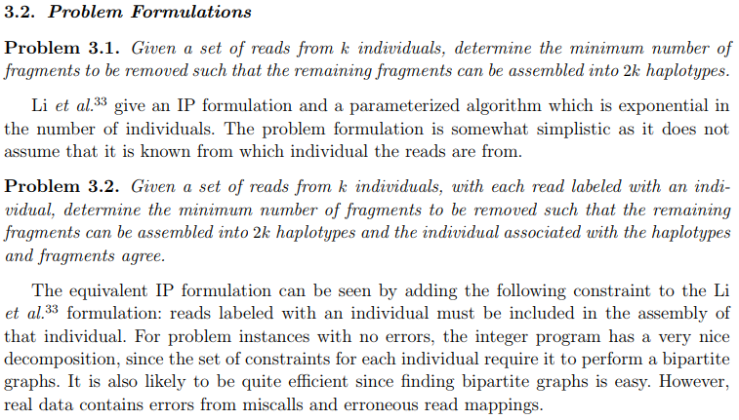
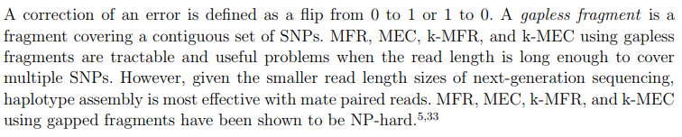
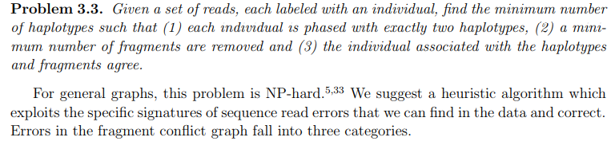
(2011.HALLDORSSON, page 5, 2nd to last paragraph) Model: Lander-Waterman-like Input: SNP Matrix

Slide 21
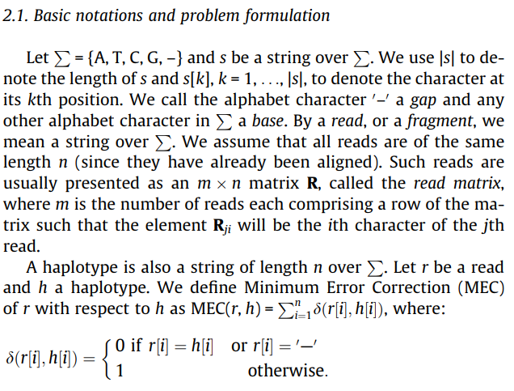
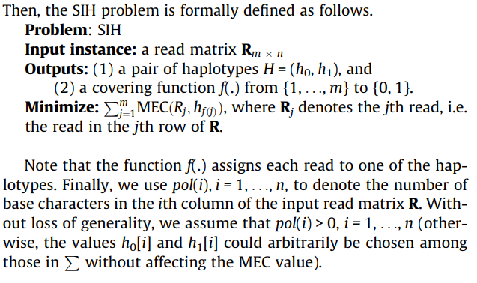
(2011.Mousavi.HapSAT, page 2, 2nd paragraph on left) Model: MEC Input: Read Matrix

Slide 22
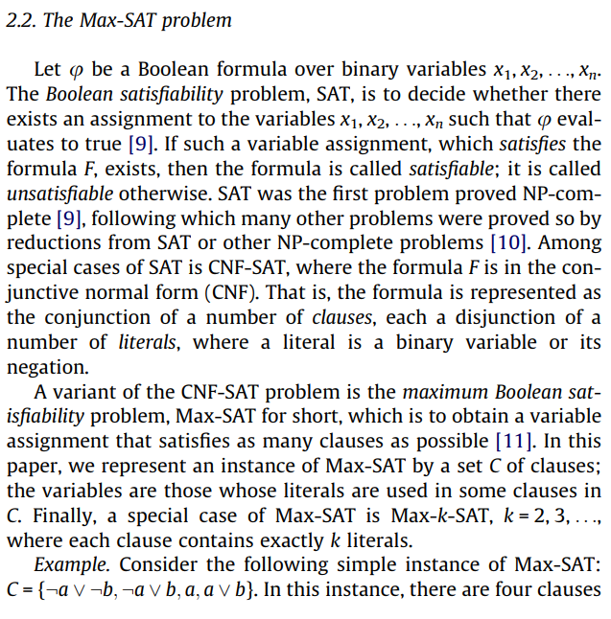
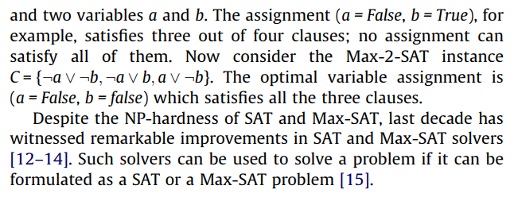
(2011.Mousavi.HapSAT, page 2, 2nd paragraph on left) Model: MEC Input: Read Matrix

Slide 23
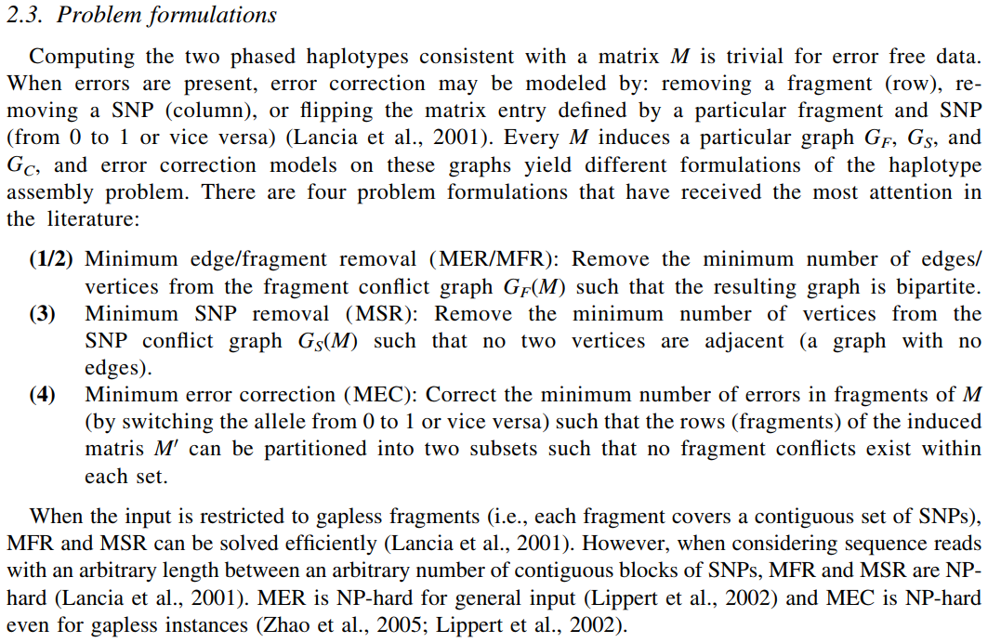
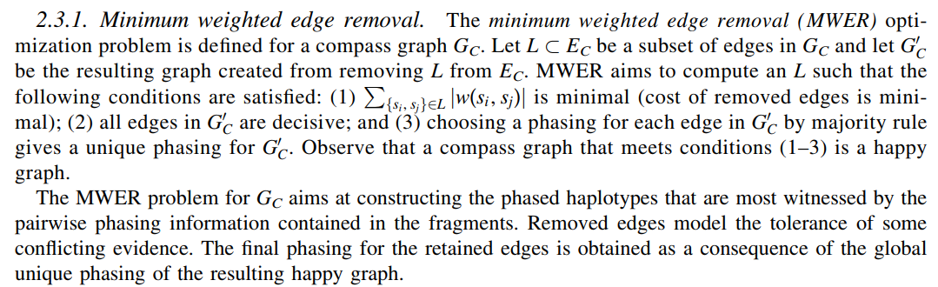
(2012.Aguiar.HapCompass, page 5, 2nd paragraph) Model: Graph Theory Input: BAM & VCF file

Slide 24
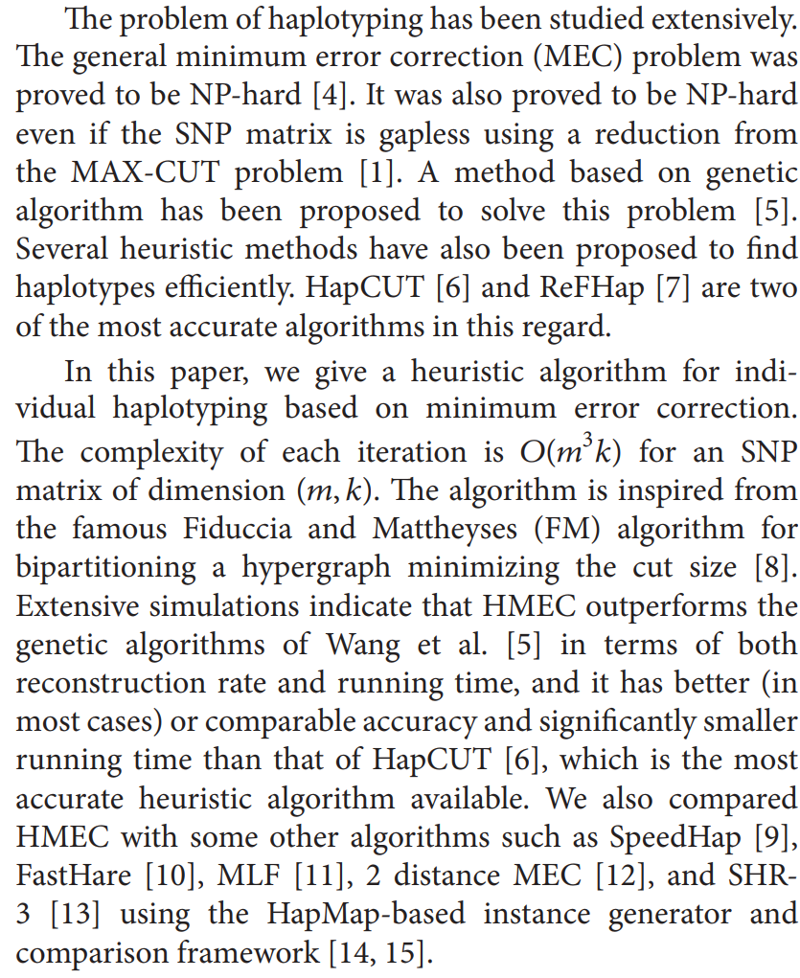
2012.Bayzid.HMEC, page 2 Model: MEC Input: SNP Martix

Slide 25
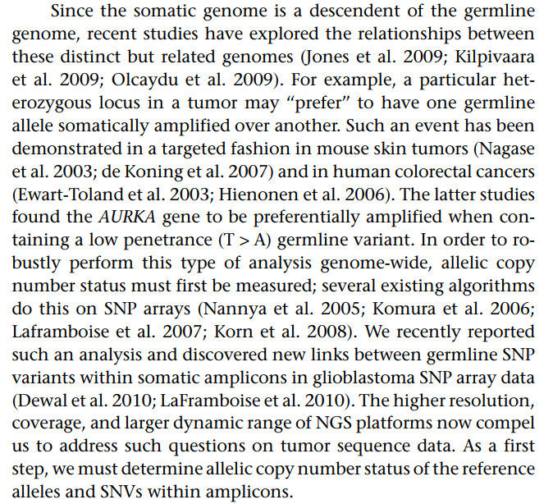
2012.Dewal.HATS, page 2, 3rd paragraph on left Model: HMM/MEC Input: Unknown

Slide 26
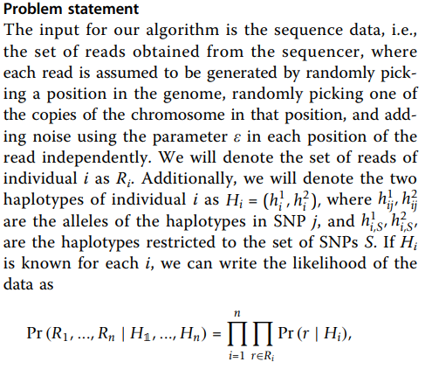


(2012.Efros.PPHS, page 2, 2nd paragraph on right) Model: perfect phylogeny model Input: sequence of reads

Slide 27



(2012.Wang.GAHap, page 2, 2nd paragraph on right) Model: MEC Input: number of fragments and length of reference genome matrix

Slide 28




(2012.Xie.HBOP, page 6, 2nd paragraph on left) Model: Dynamic programing algorithm Input: SNP Matrix

Slide 29

2012.Zhi.HapSeq, page 2, 2nd paragraph on left Model: HMM LD-based model Input: VCF file & BAM file

Slide 30

2012.Delaneau.SHAPEIT, page 1 Model: HMM Input: Unknown

Slide 31


2012.Williams.HAPIUR, page 1 Model: HMM Input: Unknown

Slide 32



(2013.Chen.Zhi, page 2, 2nd paragraph on right) Model: MEC Input: Read/SNP site Matrix

Slide 33



2013.Deng, pages 1 & 2 Model: MEC Input: Fragment Matrix
(Abstract)

Slide 34


2013.He.Hap_seqX, pages 1 & 2 Model: HMM Input: Unknown

Slide 35


2013.Matsumoto.MixSIH, page 3, left side Model: Mixture Model Input: Aligned Fragments

Slide 36



2013.Yang.HARSH, page 2, left side Model: probabilistic model Input: .bam, .bam.bai & .vcf

Slide 37



2013.Zhang.DBM, page 1 & 2 Model: dynamic Bayesian Markov model Input: SNP file & Read count file

Slide 38


2013.Zhang.HapSeq2, pages 1 & 2 Model: MCMC Input: vcf, sorted bam, indexed bam, list of indiv.

Slide 39

2013.Delaneau.SHAPEIT2, page 1 Model: HMM Input: Unknown

Slide 40

2014.Aguiar.HapCompass_Tumor, page 2 Model: Graph Theory Input: sequence reads, variant calls & # of distinct haplotypes = k

Slide 41


2014.Berger.HapTree, page 2 Model: maximum-likelihood estimation Input: Reads & VCF file

Slide 42



(2014.Chen.HGHap, page 2, last paragraph on left) Model: Hypergraph Input: SNP Matrix

Slide 43



2014.Kuleshov.ProbHap, pages 1 & 2 Model: dynamic programming algorithm Input: SNP Matrix

Slide 44



2014.Matsumoto.CSP, page 2 Model: statistical phasing method Input: genotype & fragment files

Slide 45



(2014.Mazrouee.FastHap, page 2, top right paragraph) Model: Fuzzy Conflict Graph Input: Variant Matrix

Slide 46


2014.Pan.WinHap2, page 2 Model: Unknown Input: genotype vectors & SNPs

Slide 47


(2015.Ahn.ParticleHap, page 3, 2nd to bottom left) Model: deterministic sequential Monte Carlo algorithm Input: SNP & Read Count files

Slide 48



(2016.HapCol, page 3, 2nd to last paragraph bottom right) Model: fixed parameter tractable (FPT) algorithm Input: Fragment Matrix

Slide 49


(2016.HapCol, page 3, 2nd to last paragraph bottom right) Model: fixed parameter tractable (FPT) algorithm Input: Fragment Matrix

Slide 50


2017.Edge.HapCut2, page 2 Model: likelihood-based probabilistic model Input: bam file & vcf file: with dipoild SNV

Slide 51


(2017.WhatsHap, page 4, 2nd paragraph) Model: a fixed parameter tractable (FPT) approach Input: Fragment & SNP Matrix

Slide 52



2018.Na.PEATH, page 2 Model: Probabilistic Evolutionary Algorithm Input: SNP Matrix

Slide 53



(2018.Olyaee.AROHap, page 2, last paragraph on right) Model: Asexual Reproduction Optimization Algorithm / Fuzzy Conflict Graph Input: SNP Matrix

Slide 54



2018.HapCHAT, page 3 Model: Unknown Input: bam & vcf file

Slide 55



2018.Tangherloni.GenHap, page 4

Slide 56



2019.Majidian HapSVT

Slide 57

2019.Majidian, HapNuc

Slide 58


2019.Majidian, HapOPT

Slide 59

SC.2018.Satas, page 3

Slide 60


SC.2018.Guo, page 2

Slide 61

SC.2017.Chu, page 1

Slide 62



Poly.2015.Das.SDhaP, page 4

Slide 63



Poly.2018.Hashemi.AltHap, page 3

